Slide 1


Adversarial Attacks on MNIST
Exploring Inference Attacks using ART Library
Presented by : Reem AL-ZOUHBY September 1, 2025
1

Slide 2

Plan
Explore the Inference attack
A
Membership Inference
Attribute Inference
B
C
Model inversion
D
Demo!!!
E

Slide 3
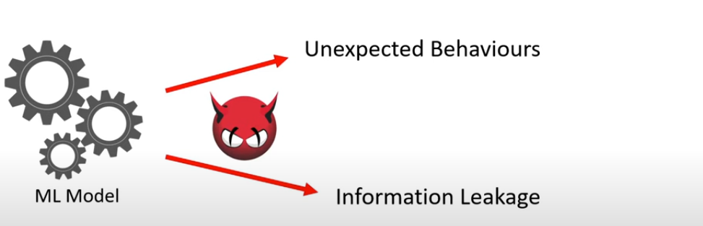
Attacks on ML

Slide 4
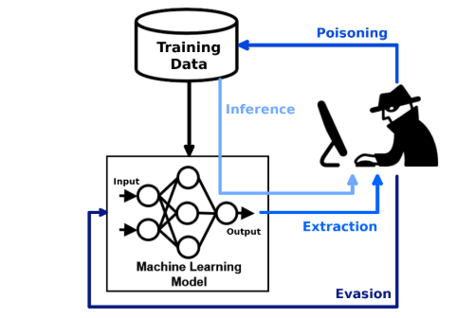

Inference Attacks

Slide 5
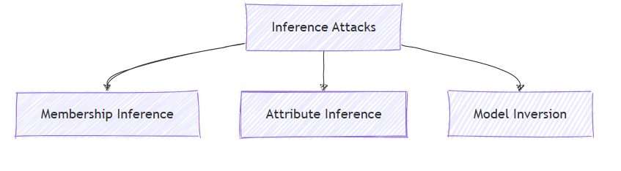

Slide 7
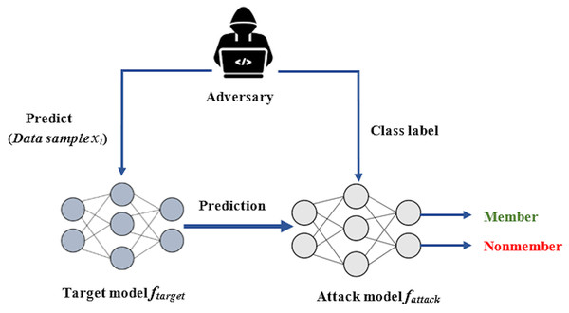

Slide 8
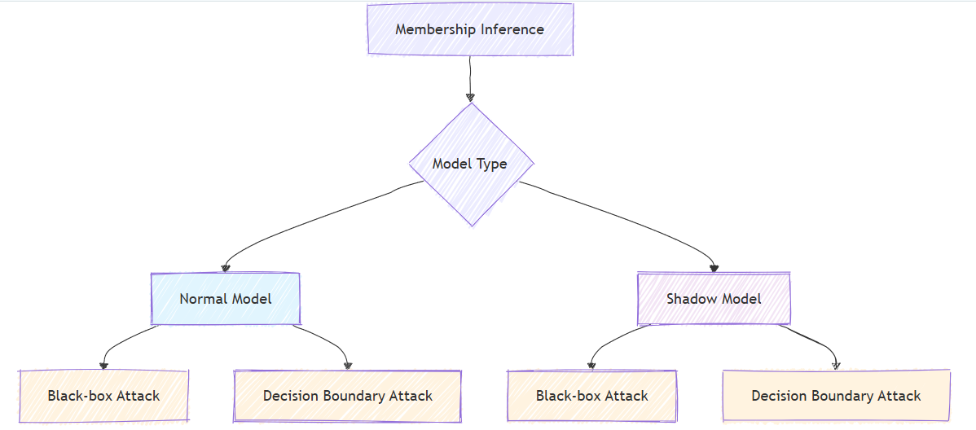

Slide 9
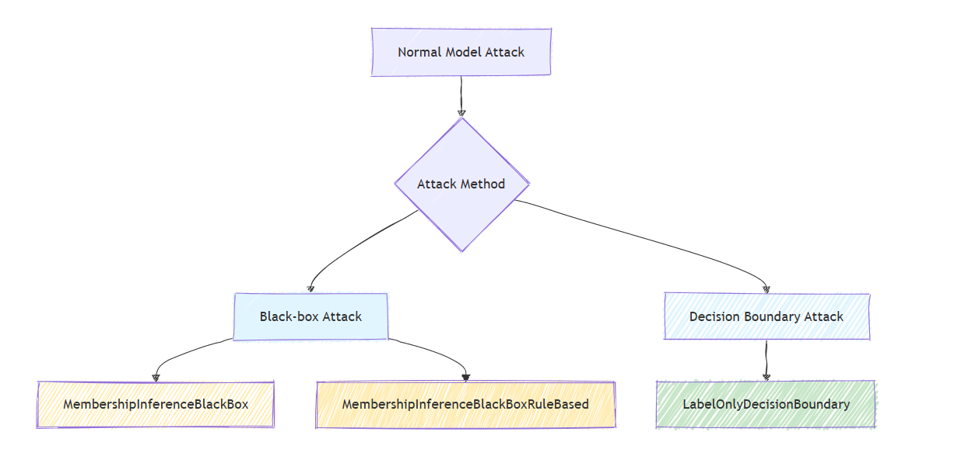

Slide 10
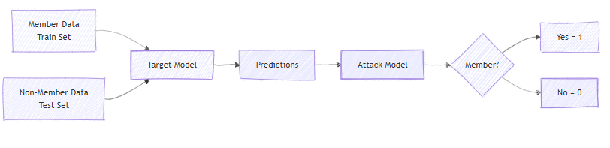
Membership Blackbox

Slide 11
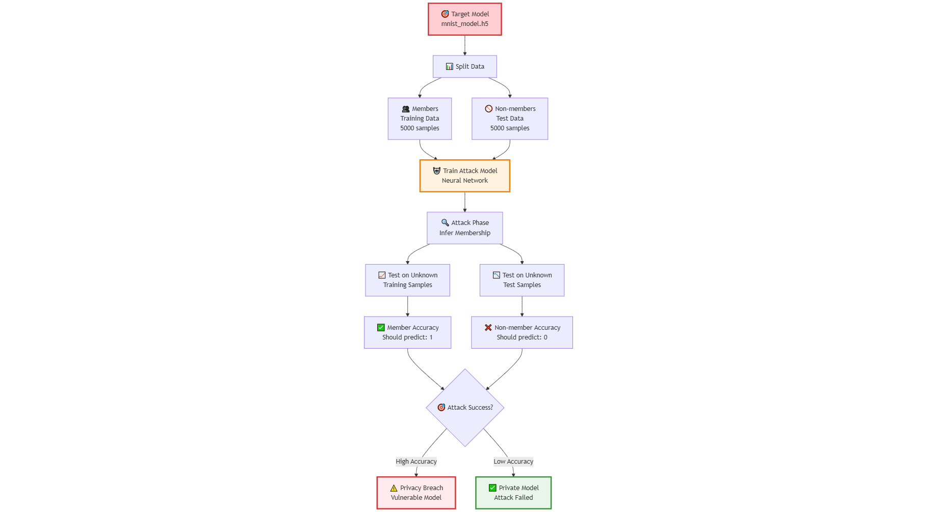

Slide 12
Membership BlackBox Rule Based
If model predicts CORRECTLY → Member (1) If model predicts INCORRECTLY → Non-Member (0)

Slide 13
Training Data (Members)
Model saw this during training
Prediction: "7" | True Label: "7" ✅
Rule Result: 1 (Member)
Test Data (Non-members)
Model never saw this before
Prediction: "3" | True Label: "8" ❌
Rule Result: 0 (Non-member)

Slide 14
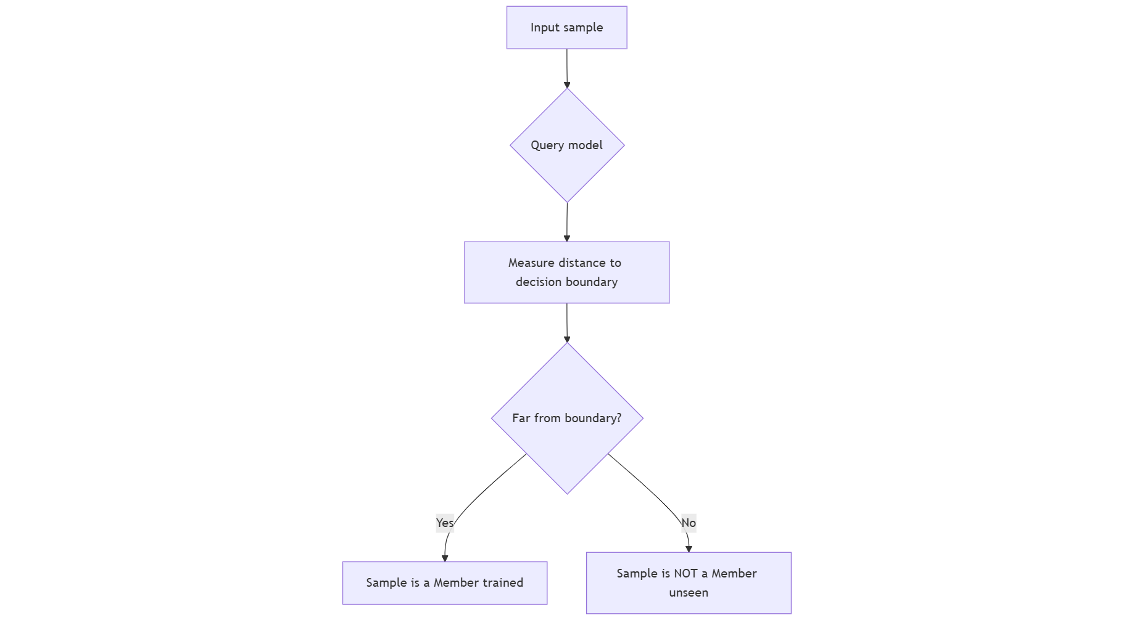
LabelOnlyDecisionBoundry

Slide 15
test/non-members → good.
training members

Slide 16
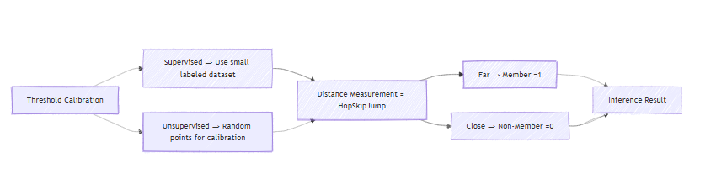

Slide 17

Shadow MOdel

Slide 18
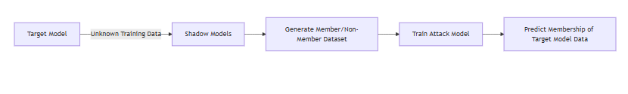

Slide 20
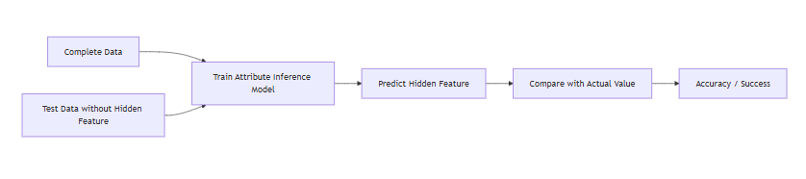
Baseline Attack

Slide 21
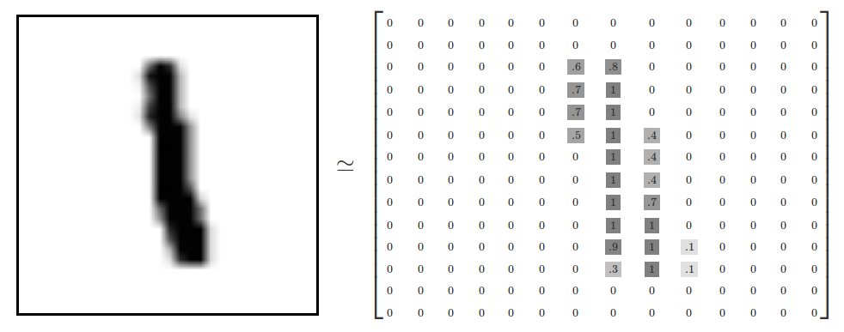

Slide 23
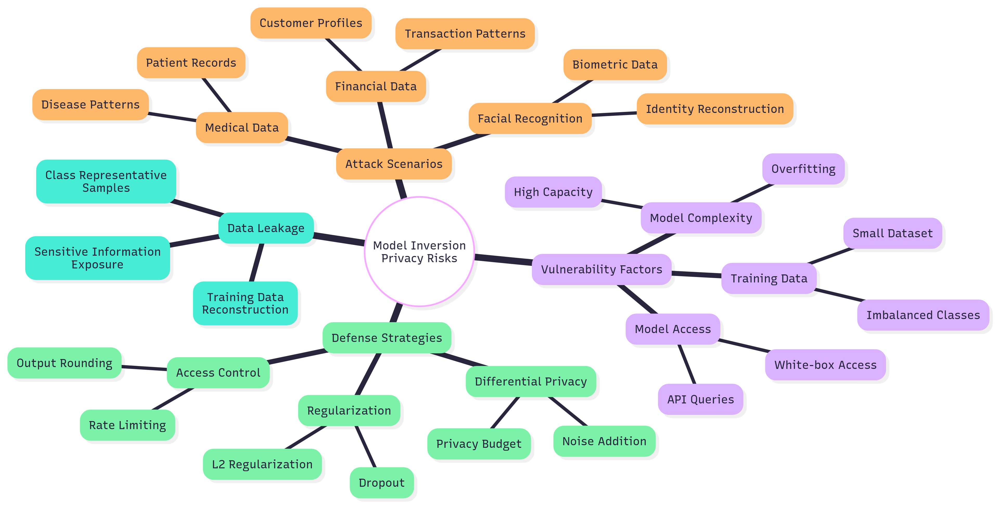

Slide 24
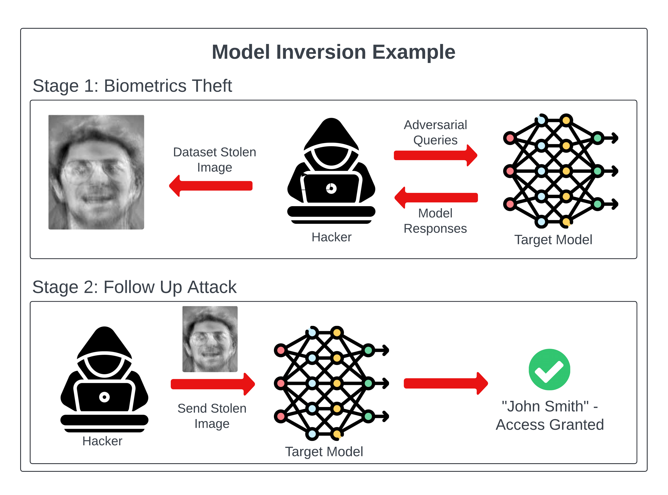

Slide 25
MIFace
The attacker is “painting” a picture of the target class. After every brushstroke, they ask the model: “Does this look more like class Y?” The model responds through gradients, and the attacker keeps adjusting until the picture matches the class.

Slide 26
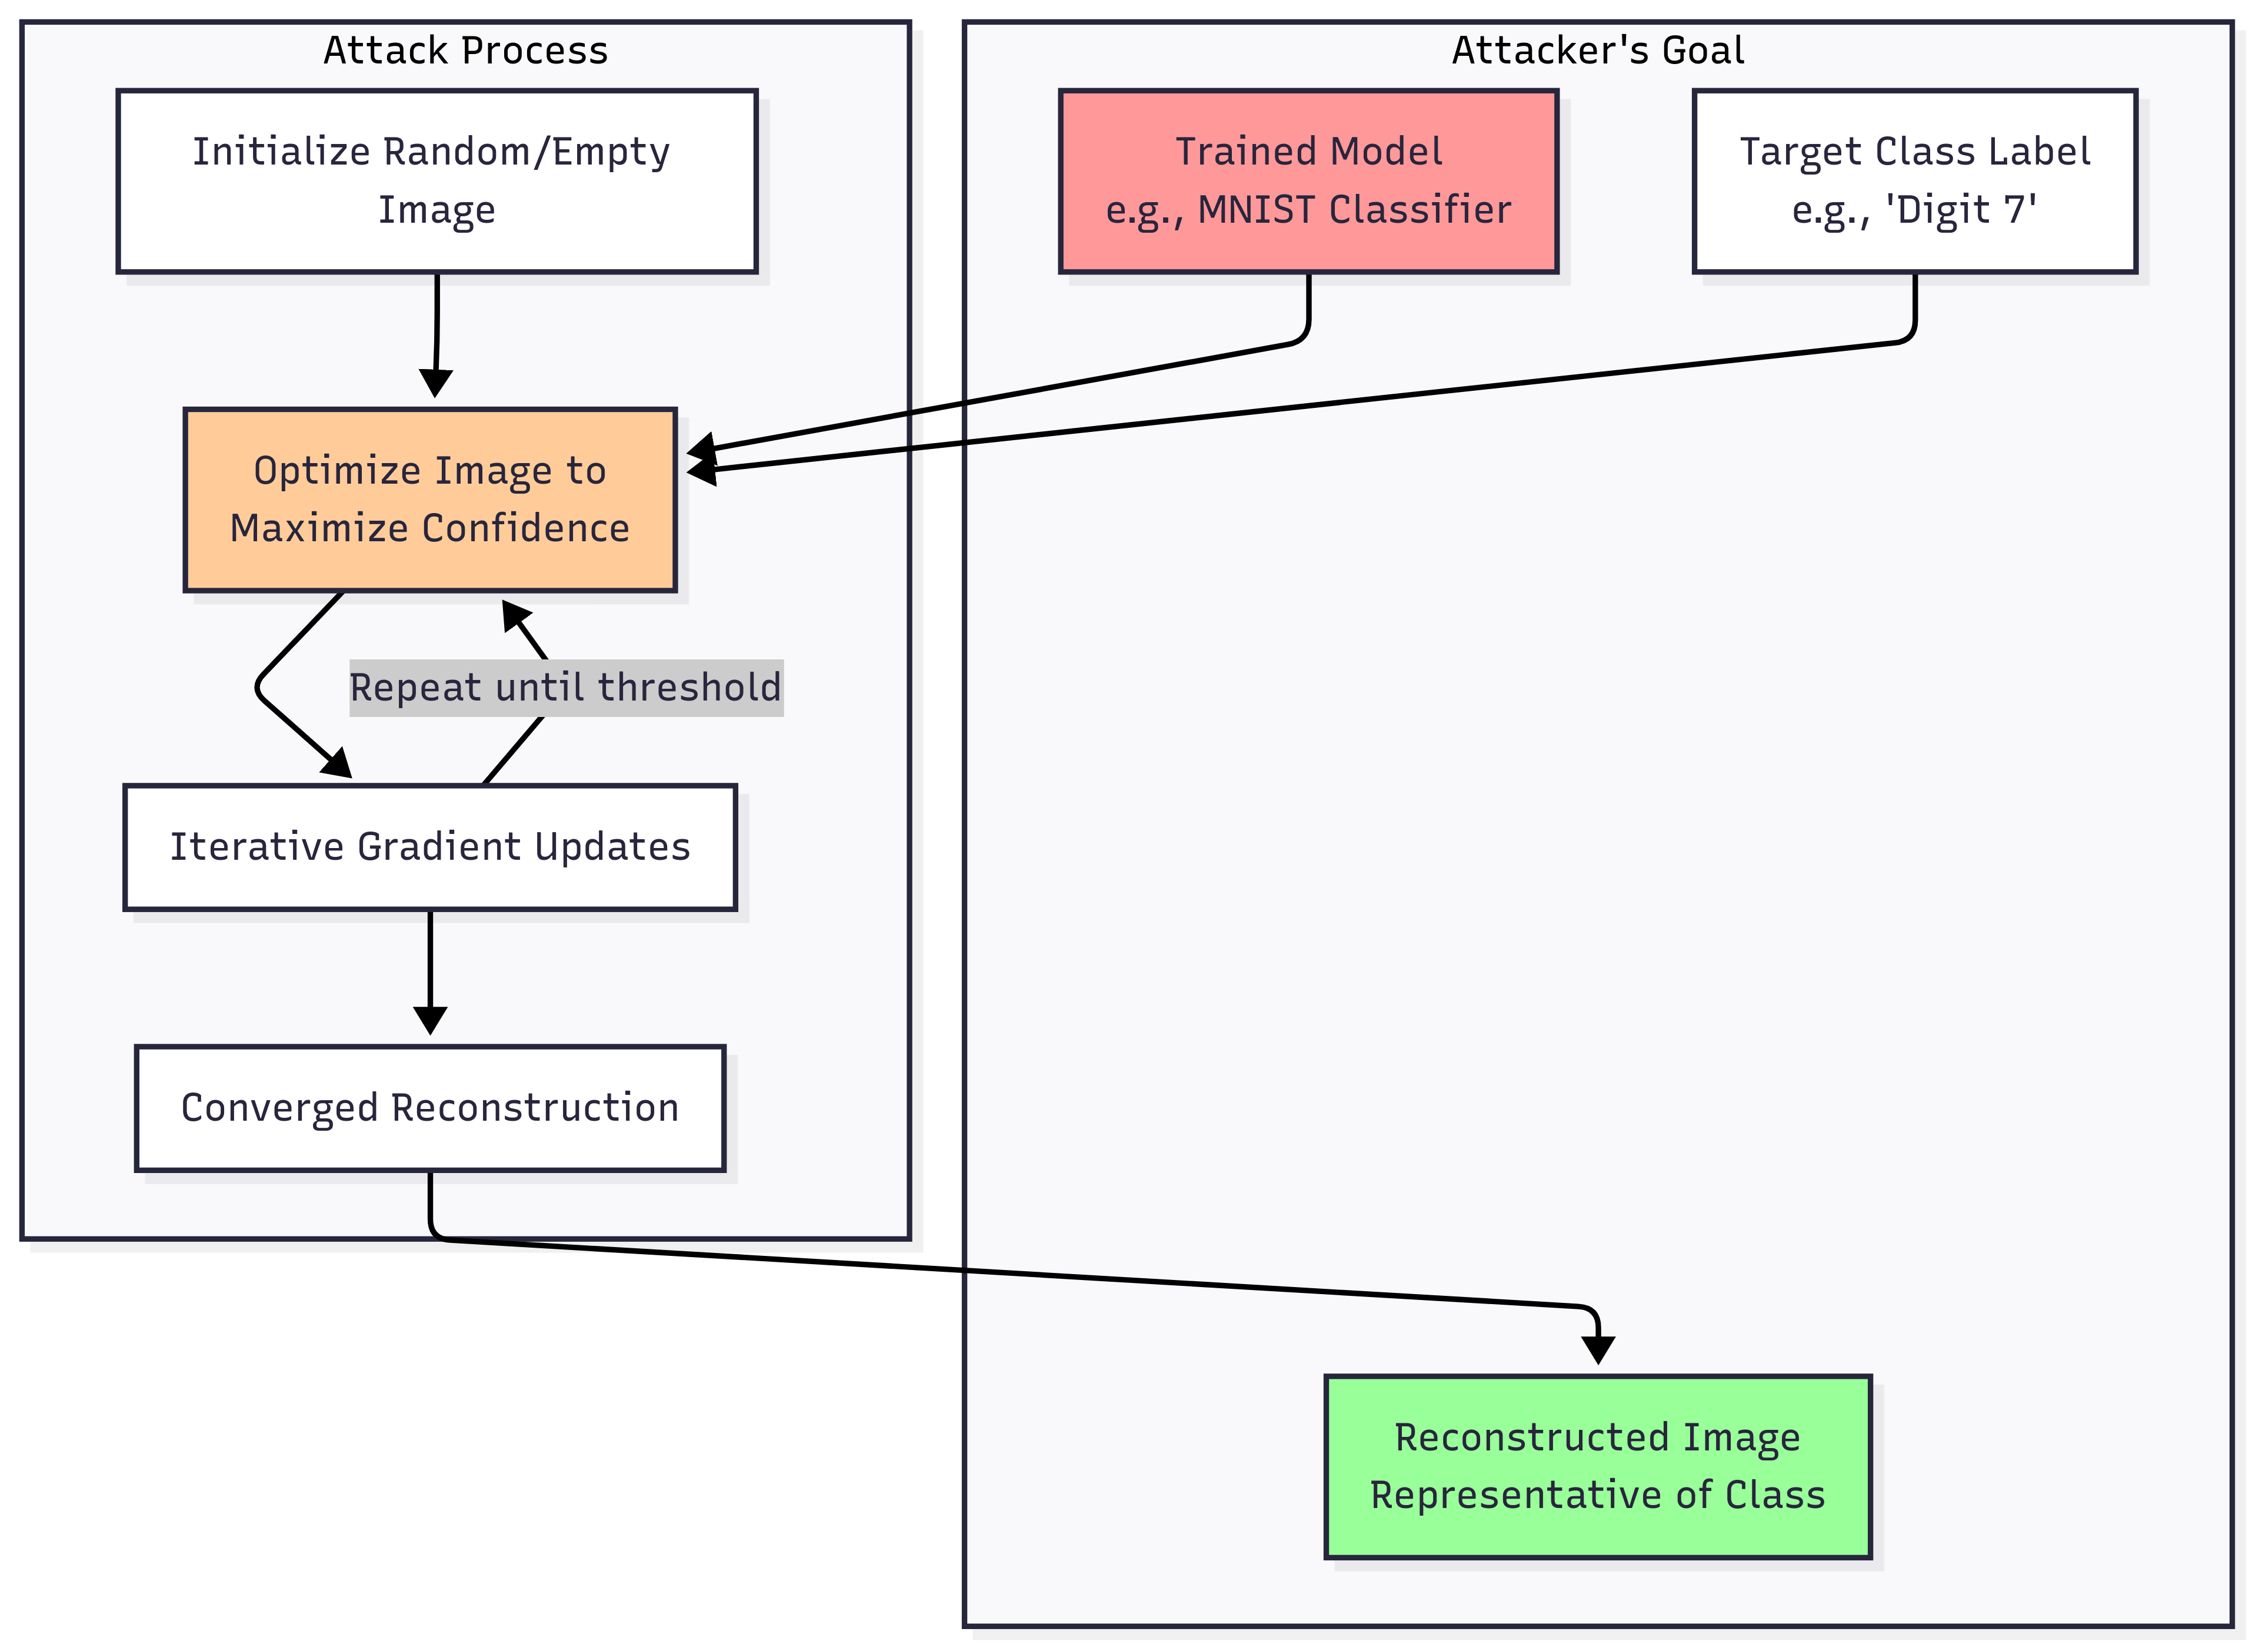

Slide 27
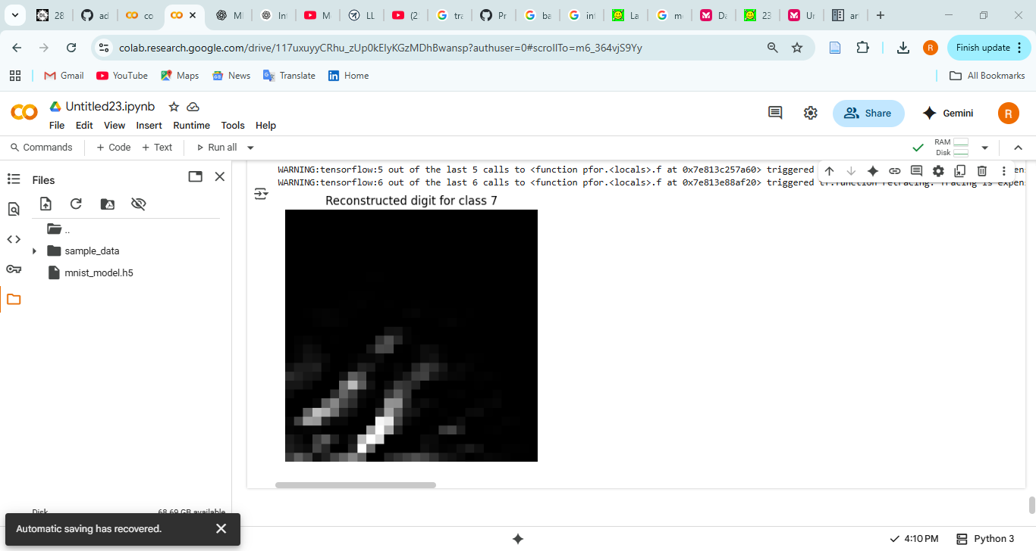
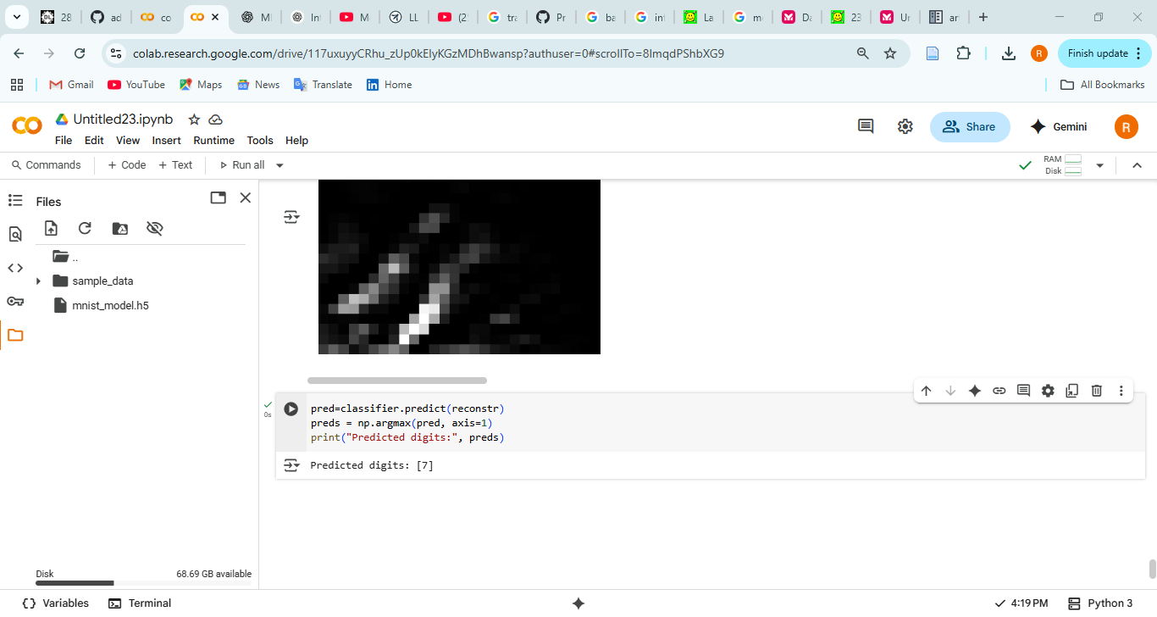

Slide 28
